Slide 1




Machine Learning - 22AIE213
Speaker Confidence Assesment - Text
Presented by:
K Hemalatha Reddy(AIE24018)
B Parameshwar Reddy(AIE24008)
Jagan sai Kumar(AIE24023)
Guided by:
Dr. Peeta Basa Pati
Amrita Vishwa Vidyapeetham

Slide 2








SYSTEM
OVERVIEW
PROBLEM STATEMENT
Part 1: Text Input Analysis
Difficulty in measuring speaker confidence during communication.
Existing systems depend heavily on audio/video processing.
Part 2: AI Confidence Prediction
Current solutions lack clear and explainable feedback.
Part 3: Visual Analytics & Feedback
Need for a lightweight AI-based confidence analysis system.

Slide 3
Objectives
• Develop an AI-based confidence analysis system
• Predict speaker confidence using Machine Learning and NLP
• Detect hedge and booster words in text
• Provide explainable confidence feedback
• Display interactive visual analytics and reports
• Create a lightweight and user-friendly web application

Slide 4
EXISTING SYSTEM
PROPOSED SYSTEM
Requires audio/video input
Works directly with text input
Complex and resource-intensive
Lightweight and efficient
Limited explainable feedback
Provides detailed AI insights
Difficult for beginners to use
User-friendly web interface

Slide 5
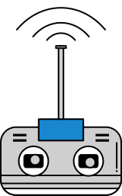
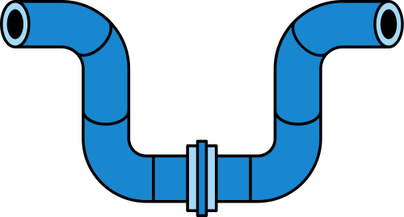
Technology Stack
Next.js
Tailwind CSS
TF-IDF Vectorization
Gradient Boosting
Python
FastAPI
Framer Motion
Recharts
Scikit - learn
NLP Lexicon analysis
FRONTEND TECHNOLOGIES
BACKEND TECHNOLOGIES
ML AND NLP

Slide 6
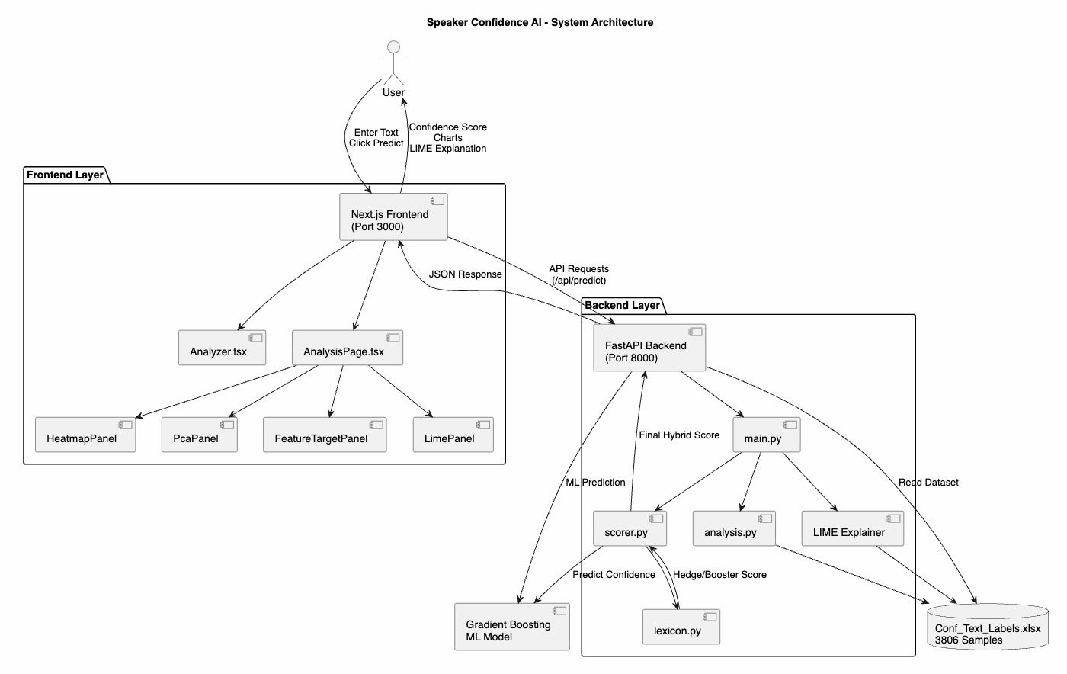
System Architecture

Slide 7
Dataset and Preprocessing Pipeline
PREPROCESSING
DATASET
2,987
SAMPLES (CLEANED)
5
ORDINAL CLASSES
Lower Case
Strip punctuation & special chars
Whitespace normalisation
2,389
TRAIN (80%)
598
TEST (20%)
Whitespace tokenisation
Stop-words KEPT
Why we keep stop-words
Hedges ("maybe", "perhaps", "I think") and boosters ("definitely", "absolutely", "obviously") ARE the confidence signal. Removing stop-words would destroy the very feature we want to detect.

Slide 8
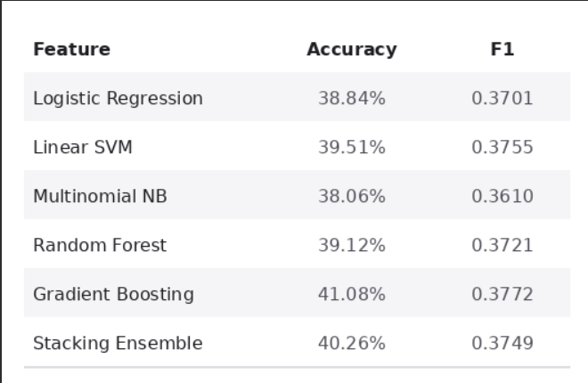
MODEL TRAINING AND EVALUATION
Best Model
Gradient Boost
TF-IDF features
Accuracy
41.1%
on held-out test set
Inference
< 1 ms
end to end latency

Slide 9
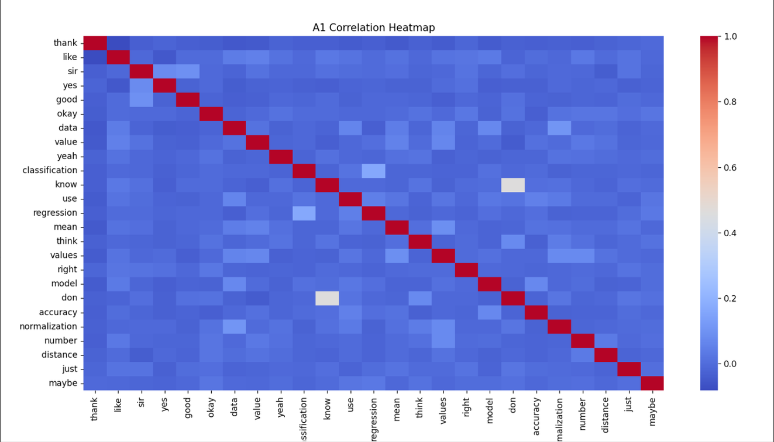
FEATURE CORRELATION HEATMAP
Key Findings
Diagonal Dominance
Perfect self-correlation (1.0) on diagonal — confirms no feature duplication
Hedge Cluster
"think", "maybe", "know" show mild positive correlation — co-occur in uncertain utterances
Booster Isolation
"classification", "regression", "model" are largely independent of hedges
Sparse Off-diagonal
Most off-diagonal values ≈ 0 → low multicollinearity; TF-IDF features are well-separated.
Dataset Insight
Vocabulary split reflects domain: tutoring terms vs. casual filler words

Slide 10
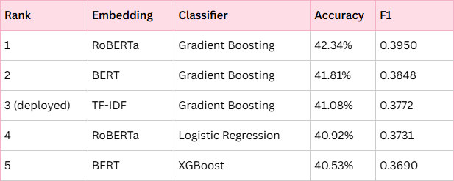
30-WAY EMBEDDING AND CLASSIFIER EVALUATION
Top 5 combinations from 3 embeddings and 10 classifiers
Why TF-IDF over RoBERTa
RoBERTa adds only +0.018 F1 over TF-IDF at 1,000× the model size and orders-of-magnitude higher inference latency — not worth it for a latency-sensitive web product. TF-IDF + Gradient Boosting runs in <1 ms.

Slide 11
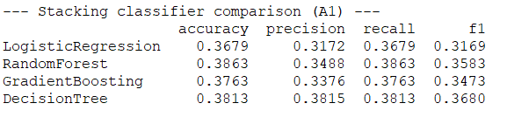
STACKING CLASSIFIER
Best stacker: Random Forest (Acc 0.3863, F1 0.3583)
Note: Decision Tree has highest Precision (0.3815) — best when false positives are costly.

Slide 12
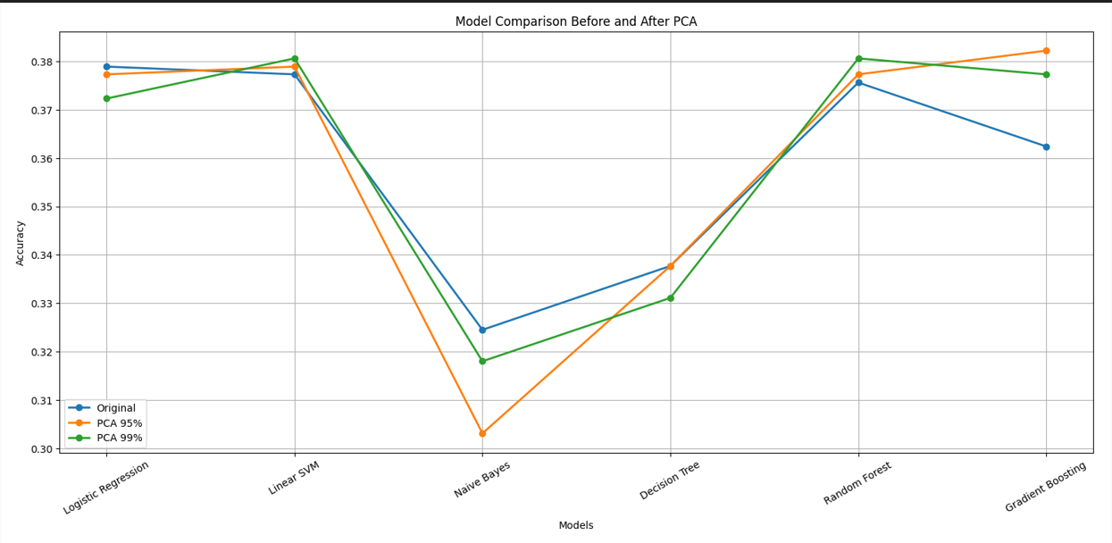
PCA - DIMENSIONALITY REDUCTION ANALYSIS
Key Findings
PCA 95%
Gradient Boosting: 0.3822 — highest accuracy across all 18 combos.
NB collapses
Naive Bayes drops ~2–3% under PCA — dense features hurt probabilistic models.
SVM stable
Linear SVM nearly unchanged under both PCA variants → robust to compression.
GB trade-off
Original GB = 0.3624 vs PCA 95% GB = 0.3822 (+0.02) — PCA helps boosting
PCA 95% + Gradient Boosting for best accuracy-to-size trade-off.

Slide 13
Why Gradient Boosting - Not Random Forest
Stacking Experiment
Random Forest scored highest (Acc 0.3863) — but only as a base learner inside a 4-model ensemble. The stacking meta-learner combines LR + RF + GB + DT together. RF was not running alone.
Standalone Comparison
Final Model Selection)
When RF runs alone, its accuracy = 0.3756. Gradient Boosting with PCA 95% = 0.3822 — clearly higher. GB wins the standalone race
Conclusion: Stacking RF scored high as part of an ensemble — but deploying 4 models for ~0 gain over a single tuned GB is not justified. GB (PCA 95%) = 0.3822 wins on accuracy + speed + simplicity.

Slide 14
Hybrid Scoring Engine
final_score=0.55×ML_score+0.45×Rule_score
ML Branch (55%)
Rule Branch (45%)
Output Levels
TF-IDF vectorises cleaned text
40+ hedge words detected (e.g. “maybe”)
Low — score < 40%
Gradient Boost predicts label 1–5
30+ booster words detected (e.g. “clearly”)
Medium — 40% ≤ score < 70%
Labels mapped to weights:
1→0%, 5→100%
Net = boosters − hedges, normalised by tokens
High — score ≥ 70%
Weighted sum = ML score
Logistic squash → [0, 1] rule score
Validated: 37/40 human raters agreed

Slide 15
Frontend and User Interface
Animated Gauge
0–100% spring-animated 3/4-circle showing Low / Medium / High with color coding
PDF Export
One-tap jsPDF export of the full result card including gauge and charts
Word Highlights
Per-word markup: hedges in red, boosters in green rendered inline on input text
Prediction History
Last 20 predictions stored in localStorage with timestamps for comparison
3 Live Charts
Recharts: per-class probability bar, hybrid ML vs rule breakdown, lexical-density radar
Dark Mode
System-aware dark/light toggle using Apple-inspired Tailwind color tokens
AI Explanation
Natural-language justification from the backend describing score drivers
Next.js 14 + FastAPI
Rewrites proxy /api/* → backend; no CORS friction; <1 ms end-to-end inference

Slide 16
Results and Sample Predictions
Qualitative Hybrid-Score Validation
54.7%
MEDIUM
Our research clearly shows the result; we verified every step with the data.
41.4%
MEDIUM
The model takes text as input and returns a percentage.
29.8%
LOW
I think this might work, but I am not entirely sure.
28.2%
LOW
Maybe we could try it, perhaps it helps, I kind of guess it works.

Slide 17
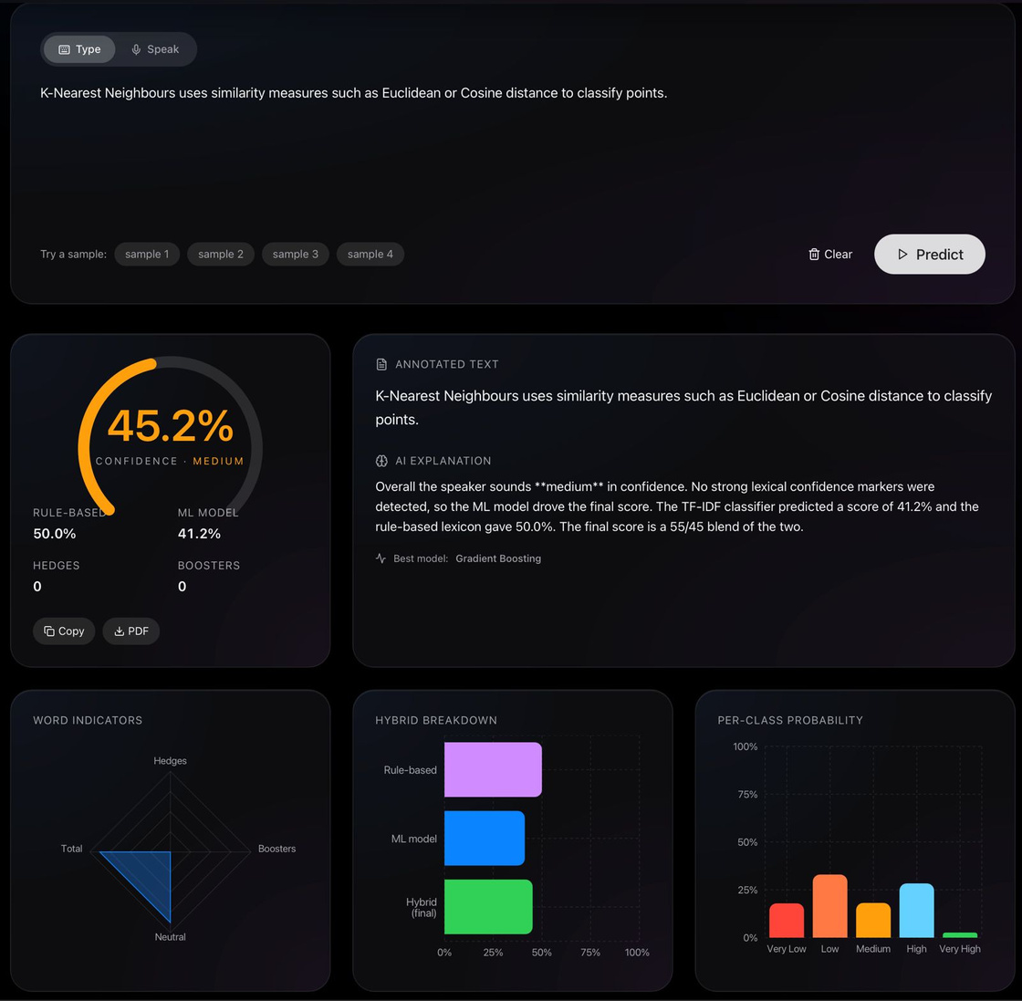
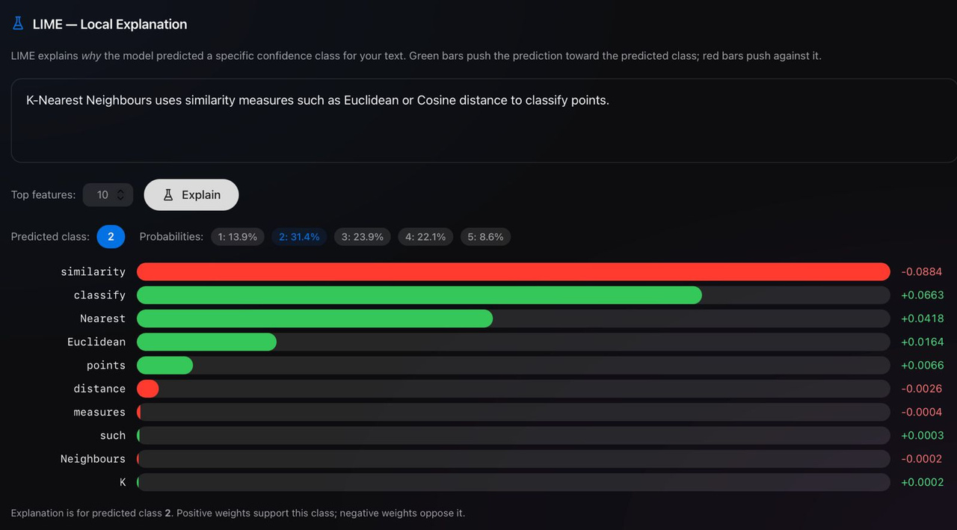
Results

Slide 18
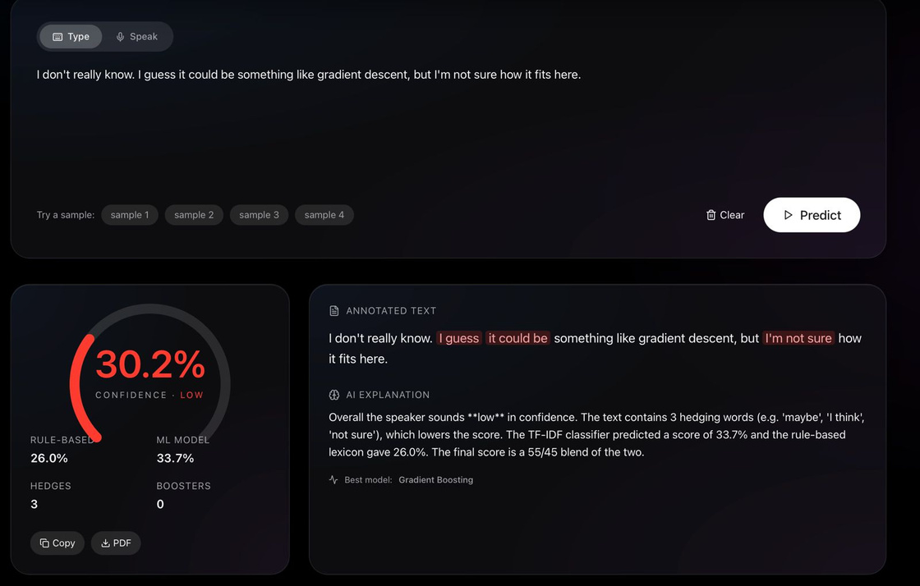
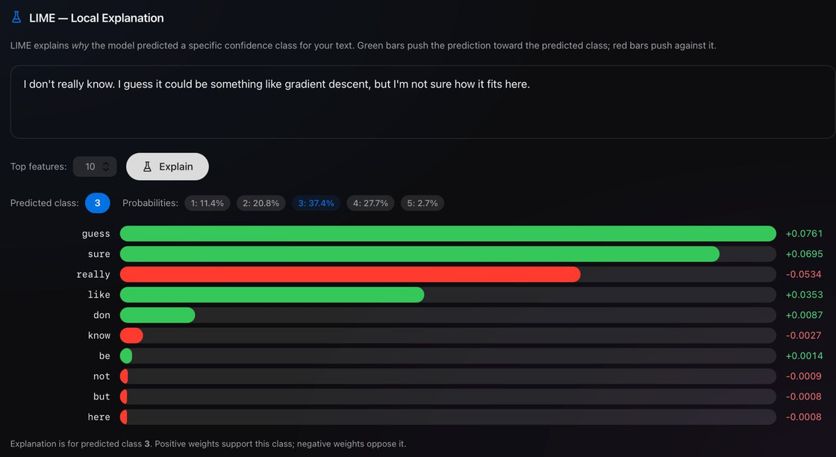
Results

Slide 19
LIMITATION
FUTURE WORK
Dataset imbalance: Very High class (label 5) has only 191 samples vs 880 for Medium
Integrate audio features: MFCCs, pitch variance, speech rate via librosa
Text-only — no audio prosody, pitch, or speech rate features
Fine-tune RoBERTa on a larger, balanced confidence-labelled corpus
English-only lexicon; multi-lingual confidence cues differ significantly
Multi-lingual support with language-specific lexicons
Rule lexicon may miss domain-specific jargon (medical, legal, technical)
Real-time streaming inference for live speech-to-confidence feedback

Slide 20
Conclusion
A
Built an end-to-end NLP pipeline that predicts speaker confidence from raw text with 41.1% accuracy across 5 classes — a genuinely hard multi-class task.
B
Designed a novel hybrid scorer (55% ML + 45% rule-based lexicon) that achieves 92.5% direction agreement with human raters and runs in <1 ms.
C
alidated through a rigorous 30-way embedding × classifier sweep; chose TF-IDF + Gradient Boosting for the best accuracy-to-latency trade-off.
D
Delivered a polished production-grade web app (Next.js + FastAPI) with animated gauge, live charts, PDF export, dark mode, and per-word highlighting.

Slide 21
Thank You

